Slide 1
Multimedia Instruction for Learning and Teaching Professional Law Enforcement
Techniques and Skills in 2020 via ILIAS
Göran Kattenberg & Bradley Naples

Slide 2
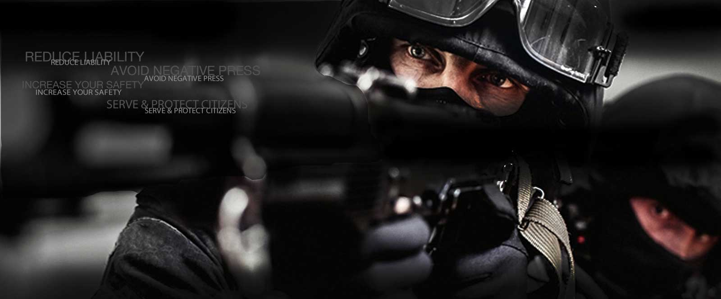
PResenters
Göran Kattenberg:
Innovation & Business Consultant Future Learning
Bradley Naples:
CEO Training Response Network: Policycommunity.net

Slide 3
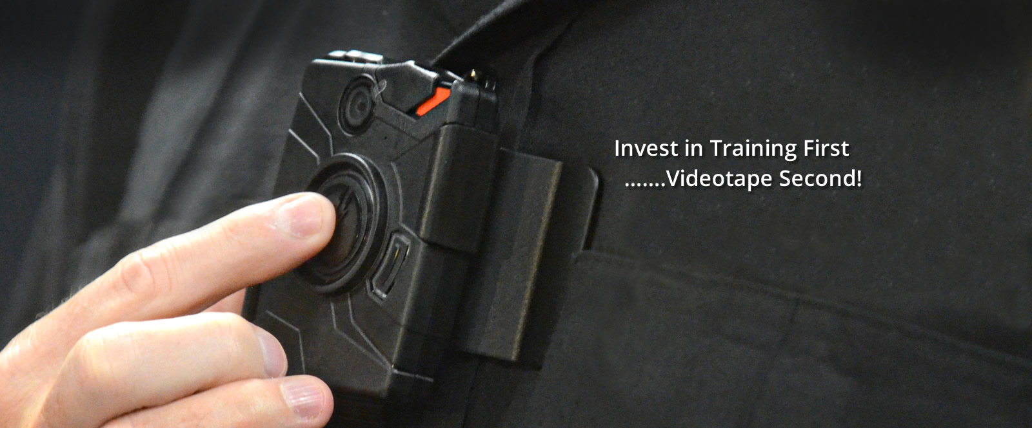
About TRN and Future Learning
U.S. Law Enforcement is in a major transitionary period due to many factors of political, wrongful arrest procedures by some police officers, inaccurate media coverage, and general societal issues
Via its law enforcement site (www.policecommunity.com) , TRN serves or has served over 40,000 law enforcement officers in academies, major city agencies, state agencies and military agencies.
while initially slow in adoption, online training for law enforcement is gaining more momentum with the profession, traditionally very slow to change
TRN provides its e-training curriculum via all platforms to include desktop, mobile device terminals (MDT’s), laptops and Apple-Android smartphones and tablets.
TRN is planning on migrating its Ilias-LMS from 4.0 to 6.1 over the next 6- months
TRN has consulted with Future Learning for various levels of assistance on Ilias 6.0+
TRN is working with FL on both a requirement for a REST/SOAP API capability to provide via Ilias 6.0+ Online Testing for Academies
TRN constantly strives to push the boundaries of media innovative course design using rich media, education as well as “training” to upgrade the knowledge of its user base
Various “brief” examples of TRN’s e-Training which can be generic or highly localized/customized to each police agency as required:
Demo of Miami Police Department’s “High Risk Felony Stops” policy course
Bias-Free Training
COVID-19 Overview for First Responders
Proper Use of Social Networking

Slide 4
Video in teaching
Video and film and other multimedia elements such as graphics, animation and sound effects have been used in teaching, training and education for many years.
During WWII video training was already used for distance learning

Slide 5
The value of audiovisual information
Video is one of the most important factors in proliferating online learning.
It is very clear that conveying the learning objective is much more complex than simply reading books tagged to explanations and answering test questions in today’s virtual world.

Slide 6
Personalized learning
Individuals all learn differently. Some by viewing, some by listening and reading and some using all methods.
Bluntly stated, one size DOES NOT FIT ALL PEOPLE.
Video and film have added a new and wider dimension of processing of textual information.

Slide 7
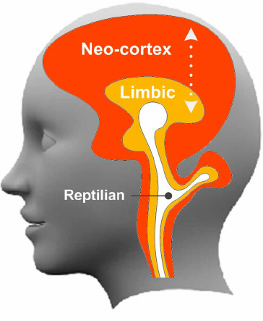
Whole brain functioning
To learn and remember what one learns it is critically important to have the options to process information by the whole brain for optimal functioning and memory retention and recall when it is required and needed.
Even more critical for professional law enforcement when called upon to make decisions in milliseconds.

Slide 8
Advantages of video in teaching
Video learning can be both passive. multidimensional and interactive
It is highly flexible in its usage.
From lecture capture, to user generated content or dedicated created material
adding information and providing ongoing and final assessment tests.

Slide 9
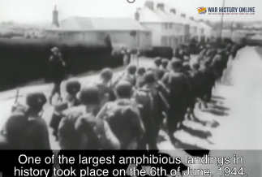
Video materials
Videos can be comprised of custom video, 3rd party video, animations, live action footage and more. - The effort can be minimal to very expansive and extensive.
As a good example when teaching history, video, diagrams, animations can all be used in combination to provide a higher-level of both educational/learning as well as entertaining the student.
As an example, take the Battle of Normandy. By adopting such a multimedia approach would offer students a more immersive and immediate insight to what is essential.

Slide 10
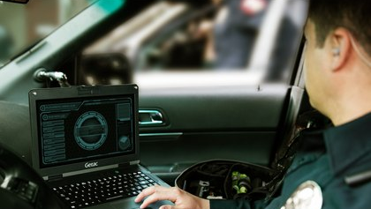
Advantages that are directly achieved by integrating video for teaching
Video materials are accessible
Students receive multichannel information
Video engages learners
Video integrates the outside world into classroom
User generated content is easy to achieve
Videos are more flexible than text
Video creates an immersive experience

Slide 11
Summary of TRN Use Case
Detailed tracking and reporting on any individuals records with certificate’s are captured to provide validation of the student’s learning for both advancement and liability requirements.
Reports are automatically e-mailed or can be pulled on-demand.
Both soft skills and hard skills are effectively teached using video.
Diagnostics and assessments guarantee compliance for different skill levels within the Police Force.

Slide 12
Current project (this year)
Important societal issues (COVID-10, BIAS, DeEscalation)
Mobile learning
Records Management
From ILIAS 4 to ILIAS 6 without RoR portal
SOAP/REST interfaces
Flexibility of Repository, e.g. to rapidly implement individual roll calls
Move to interactive video formats

Slide 13
Current Goals (short term)
Migrate to ilias 6 for all functionality
Layout and design according to policecommunity.com
Multi devices (mobile)
Multiple scenarios
Connect to new records management system
LTI for connecting to (interactive) video streaming platforms
Analytics

Slide 14
Problems and Solutions
ILIAS 4 and RoR portal are not scalable anymore – ILIAS 6 provides the technical solution
For this target group it is very important to provide specific didactical forms – ILIAS 6 provides the functional solution
From a didactic point of view it is important to deeply train in to habits (3 layer model of the brain)
Short effective 2/3 minute nuggets provided in a branching scenario
From a content point of view video stays the most important format
Topics that are currently very important are COVIC-19, BIAS, DeEscalation
Content is available and will be available in multiple languages including German, French, Dutch and others
Roll Call is a very important concept (onboarding flexibility based on actual skills/knowledge/attititude

Slide 15
Short demo with ILIAS 6
Future Learning ILIAS 6.4

Slide 16
Q&A
Let us know if you have any questions or remarks

