Slide 1
Re-Designing ILIAS for a challenging User group
Fred Neumann, Michael Zwanziger & Sónia Hetzner

Slide 2


Who we are?
Research & Development
Technology enhanced learning Systems since 1990
ILIAS users and contributors since 2001
30 People
10th largest University in Germany
40.000 Students
Nearly every subject

Slide 3
Challenging Target Group?

Slide 4
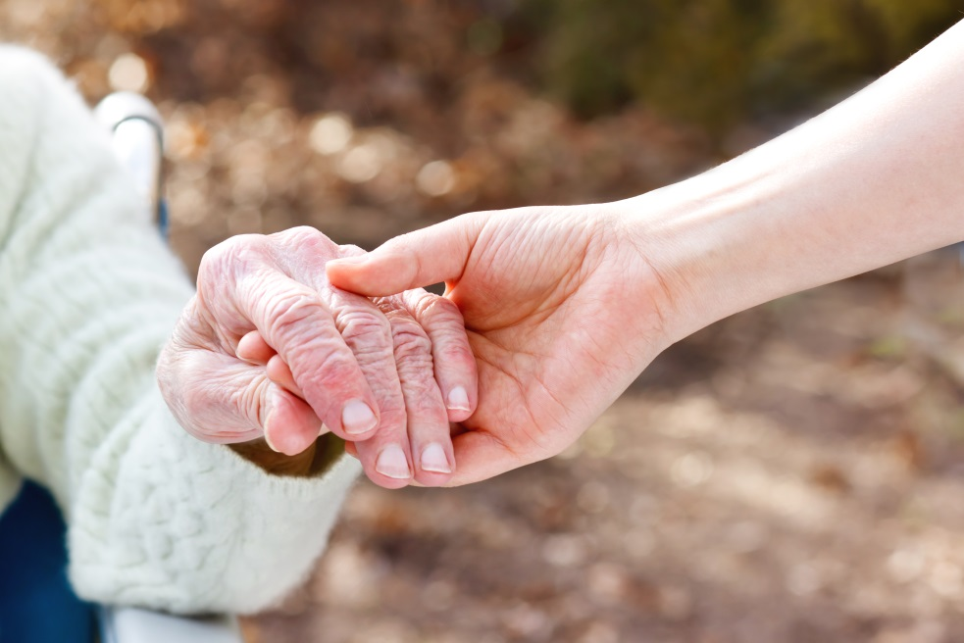
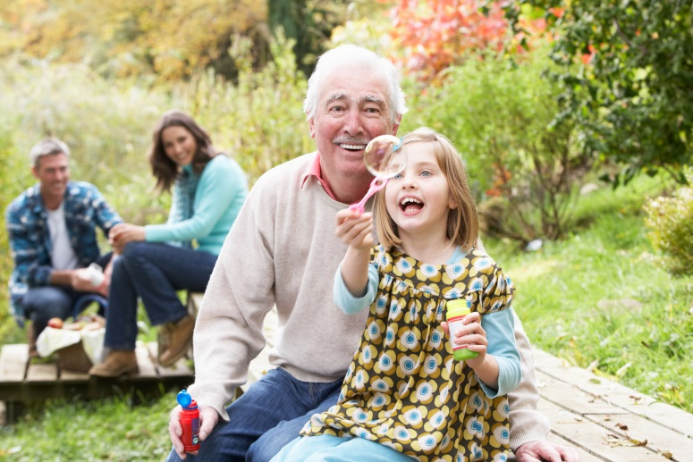
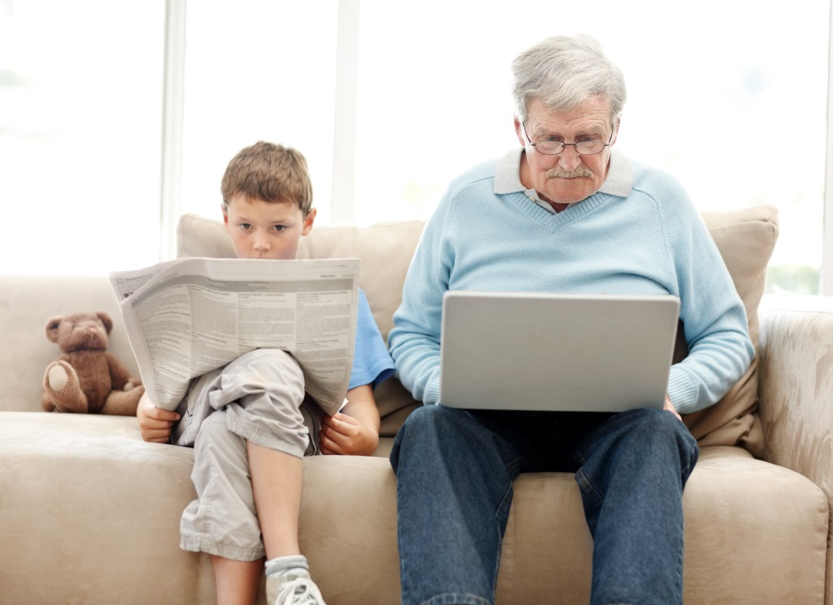

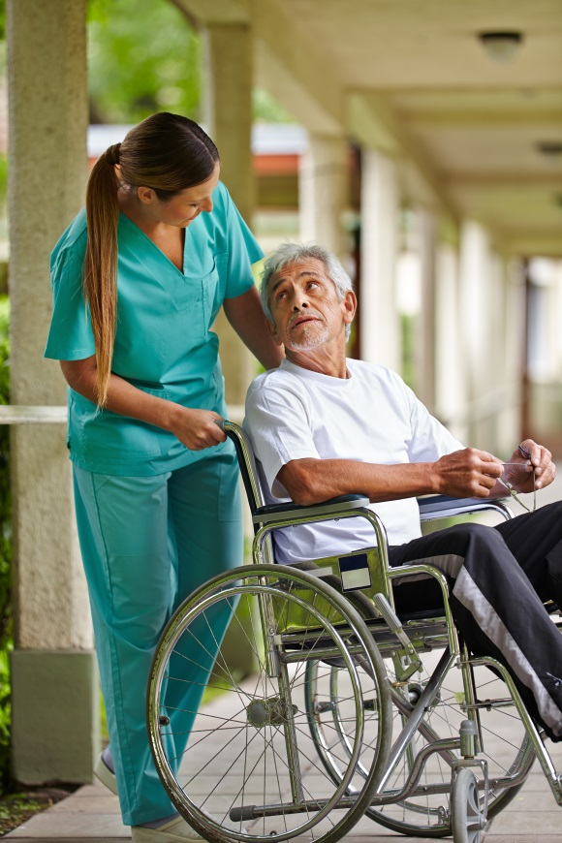

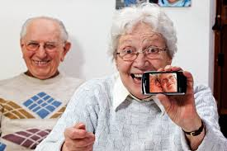
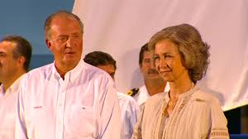
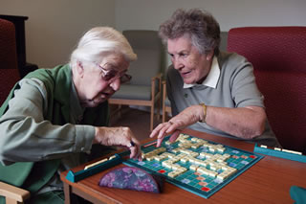

Slide 5
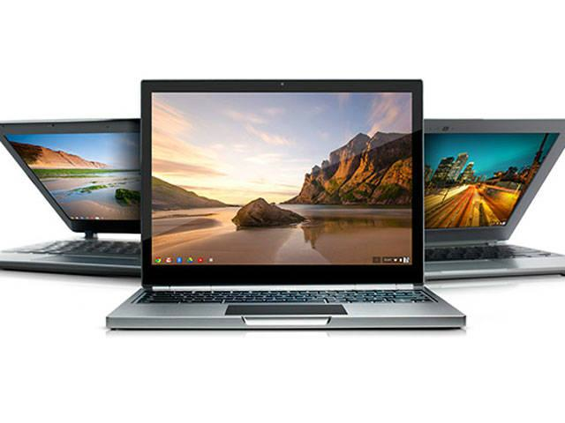
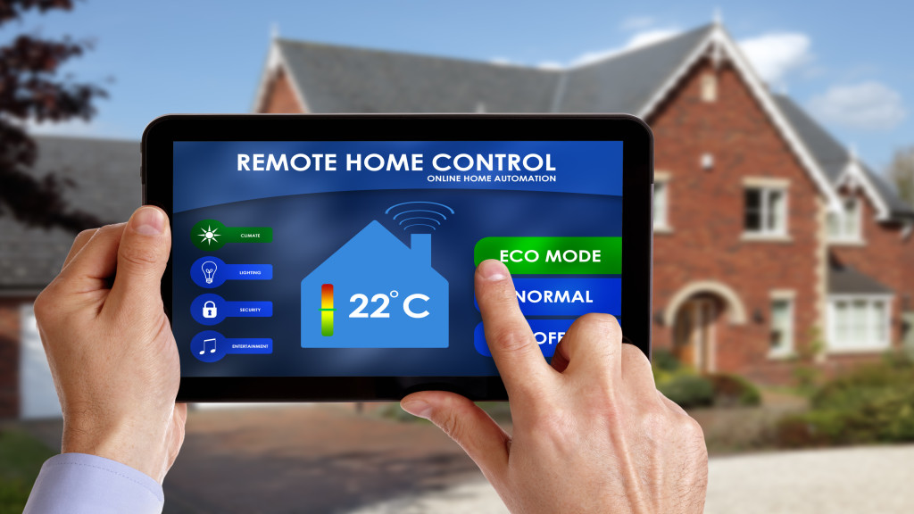
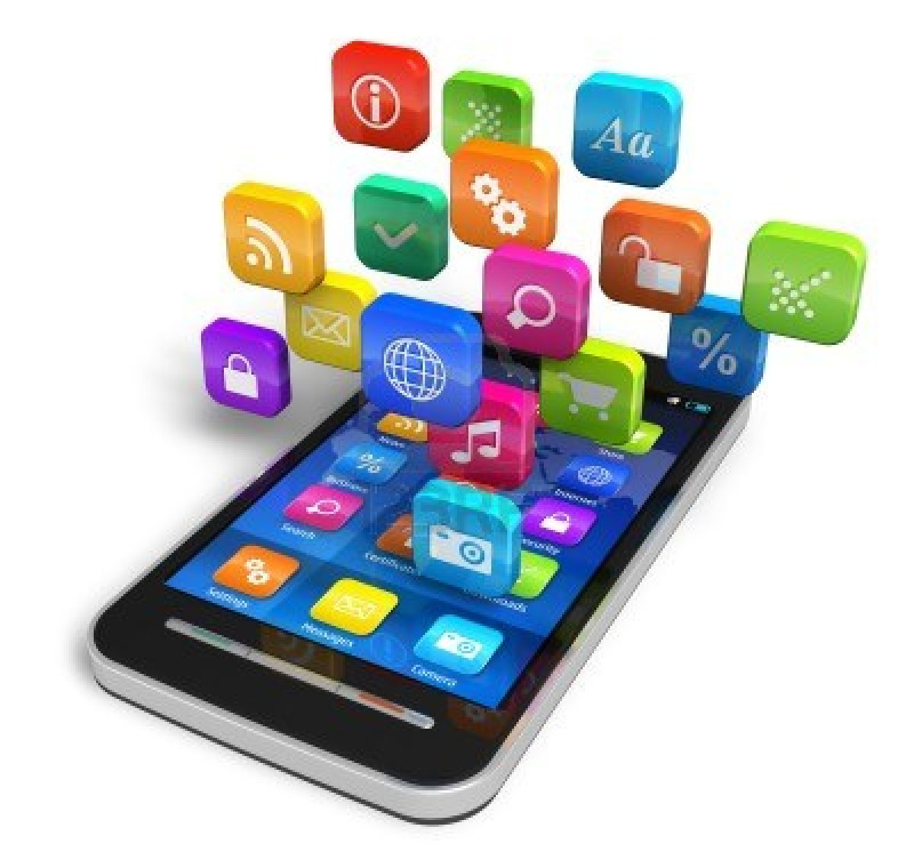
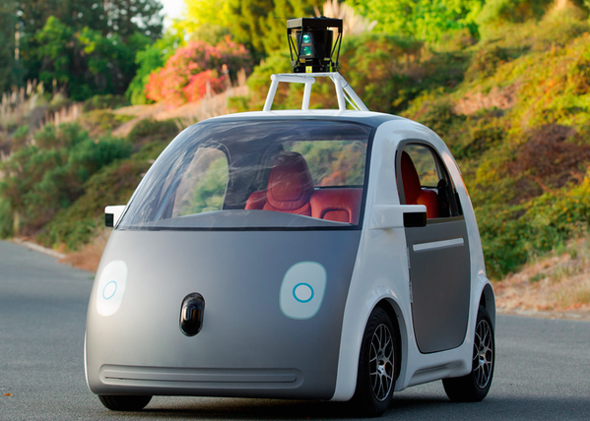
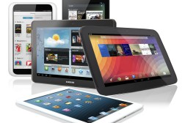

Slide 6
Demographics are changing
Germany 2010
82 Mill.
26% >60
Germany 2060
70 Mill.
40% >60
18% < 20
15% <20

Slide 7
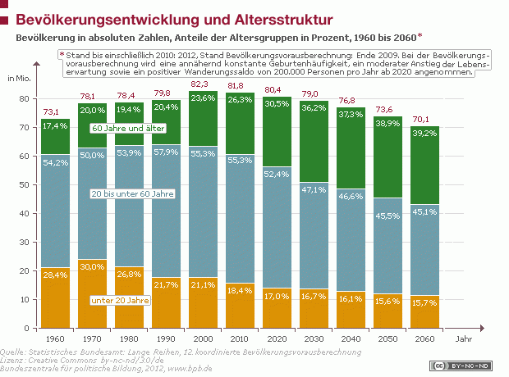

Slide 8

Seniors as a learning generation
Similarities
  Experience of a life
  Maniful interests
  Time & Commitment
  Afraid of but curious of New technologies
Differences
  Social-economic background
  Educational background
  Learnabilitiy, -tradition and –motivation
  Age and Aging

Slide 9
Research
Tablets and Seniors as good starting point for ICT competence development
  Simplicity: There are few things to care about in order to start using a tablet-PC
  Mobility: Easy portable and always ready to use due to low starting time
  Easiness: With a relatively low level of e-skills
  Ap(p)titude: The app concept – short cut to the task
  Touchable The easy to understand and use touch screen

Slide 10
The Challenge

Slide 11

E-Learning Systems for Seniors
What?
Mobile learning System for Seniors
Focusing on Internet and Tablet-Computer competences
For unexperienced Seniors
For seniors often living in the country side with low Internet band width

Slide 12
The Project

Slide 13

Seniors Learning with Apps

Slide 14


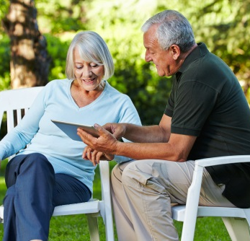
The Facts
LLP 2013 Grundtvig (Erasmus +)
Budget: 345.346 €
Grant EC: 258.906 €
Duration: 01.01.2014 – 31.12.2015

Slide 15

Partners
P1: ILI
University of Erlangen-Nuremberg
Institute for Innovation in Learning
Sónia Hetzner, E-mail: sonia.hetzner@ili.fau.de
URL: http://www.ili.fau.de
P2: ESE
E-SENIORS association
Monique Epstein, E-mail: epstein@free.fr
URL: http://www.e-seniors.asso.fr
P3: SCU
Jaume-I University, Senior Citizens' University
Pilar Escuder-Mollon, E-mail: mollon@uji.es
URL: http://mayores.uji.es
P4: GIE
Grupul pentru Integrare Europeana
Georgeta Chirlesan, E-mail: g.chirlesan@gie.ro
URL: www.gie.ro

Slide 16



Aims
Developing a training App
for Seniors
Competent and self-directed
use of Tablet-Computers
In 4 Countries and Languages
  Germany
  France
  Spain
  Romania
Notes:
The project SenApp – Seniors Learning with Apps – aims at develop-ing a training App dedicated to supporting the older generations to use and take advantages of tablet computers to become competent consumers, of Internet information and contributors to the knowledge society. Because the digital divide still concerns the older population to a major extent.
In a mobile learning environment, seniors have access to training, that:
• Leads the learner into the ICT world through a comprehensive step-by-step approach
• Supports efficiently self-directed learning
• Supports seniors to overcome age related impairments
• Includes a well-organized tutoring system
• Includes ways for promoting social learning
• Integrates a variety of multimedia elements (demonstrations, audio-visual elements, interactive exercises)
• Is offered through a customised mobile learning environment
The project gives a special focus to seniors that fear face-to-face training offers, are restricted in their mobility or have diverse impair-ments or disabilities.
For the long-term sustainability of the project results authoring and implementation guidelines for the SenApp approach can be down-loaded on the project website or requested from the project team (see contact).
The project is funded by the European Lifelong Learning Program and involves partners from four European countries: Germany, France, Spain and Romania. The training App is also available in the four project languages and in English.

Slide 17
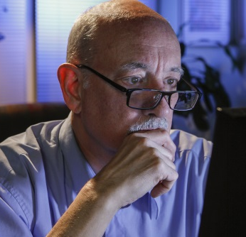
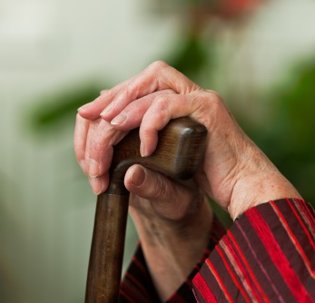
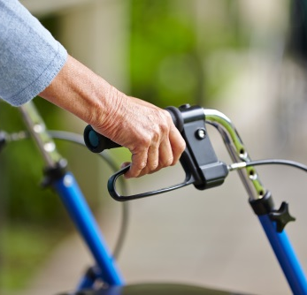
Target Group
E-excluded Seniors due to
  emotional fears
  restriction of mobility
  diverse impairments or disabilities
  lack of support
  lack of training offers in the neighbourhood

Slide 18
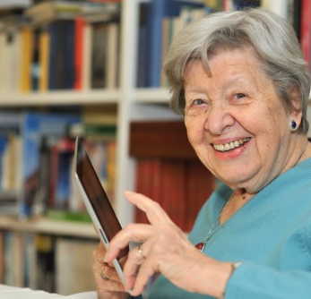


Products
The SenApp-App
  Dedicated to Tablet PCs
  Explaining ICT-concepts
25 Learning Units
  Multimedia-enriched didactic elements
  In French, German, Romanian, Spanish
Implementation eBook
Notes:
For the long-term sustainability of the project results authoring and implementation guidelines for the SenApp approach can be down-loaded on the project website or requested from the project team (see contact).

Slide 19

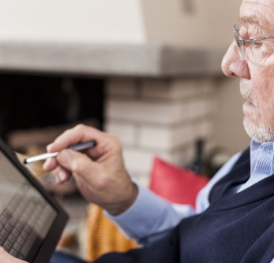

Key aspects
comprehensive step-by-step approach
Supports efficiently self-directed learning
Supports to overcome age related impairments
Includes a well-organized tutoring system
Includes ways for promoting social learning
Integrates a variety of multimedia elements (demonstrations, audio-visual elements, interactive exercises)
Notes:
The project SenApp – Seniors Learning with Apps – aims at develop-ing a training App dedicated to supporting the older generations to use and take advantages of tablet computers to become competent consumers, of Internet information and contributors to the knowledge society. Because the digital divide still concerns the older population to a major extent.
In a mobile learning environment, seniors have access to training, that:
• Leads the learner into the ICT world through a comprehensive step-by-step approach
• Supports efficiently self-directed learning
• Supports seniors to overcome age related impairments
• Includes a well-organized tutoring system
• Includes ways for promoting social learning
• Integrates a variety of multimedia elements (demonstrations, audio-visual elements, interactive exercises)
• Is offered through a customized mobile learning environment
The project gives a special focus to seniors that fear face-to-face training offers, are restricted in their mobility or have diverse impair-ments or disabilities.
For the long-term sustainability of the project results authoring and implementation guidelines for the SenApp approach can be down-loaded on the project website or requested from the project team (see contact).
The project is funded by the European Lifelong Learning Program and involves partners from four European countries: Germany, France, Spain and Romania. The training App is also available in the four project languages and in English.

Slide 20
The Design Challenge

Slide 21

E-Learning Systems for Seniors

Slide 22
SenApp Puzzle
Diversity
ICT-ground zero
Age-related needs
European Project
E-Learning
E-Inclusion
Mobile learning
Individual needs
Tablet-PCs
iOS & Android
Connection problems
Bandwidth
Notes:
E-Learning als Lernen, welches durch die Verwendung von Informations- und Kommunikationstechnologien unterstützt bzw. ermöglicht wird.
CBT (Lernprogramme, CD-Rom)
WBT (Lernen über Netzumgebungen wie Internet oder Intranet)
Online-Learning (Lernen im Netz, Lernende und Tutoren auf einen Server zu, auf dem die relevanten Daten gespeichert sind und kommunizieren synchron und/ oder asynchron miteinander. )
Distance Learning (Fernstudium)
Blended Learning (Mischen von Präsenz- & Online-Lernen)
Formen des E-Learning:
CBT (CD ROMS) / WBT (E-Learning-Module auf Zentralservern gespeichert & TN zur Verfügung gestellt)
Unterstützung der Präsenzlehre (Materialbereitstellung, Telekommunikation)
Bereitstellung von einzelnen Lernmodulen im Internet („Wissensdatenbank“)
Blended-Learning als Mischform
Komplette (betreute) Kurse über das Internet
➔ Fazit: Einsatzzweck und die Rahmenbedingungen bestimmen Gesamtaufbau des Kurses und Aufbau & Struktur der Lernmaterialien!

Slide 23

Out of the process...
R1: Support beginners (Simplify)
R2: Support offline
R3: Support mobile learning
R4: Support iOS –
complicated App Process
R5: Support Android –
do an App
R6: Support social learning
Forum continuous update
R7: Support guidance
through learning pace
(continuous dowload othe units)

Slide 24
Bi-directional Process
Pedagogical Needs
Technical Possibilities

Slide 25


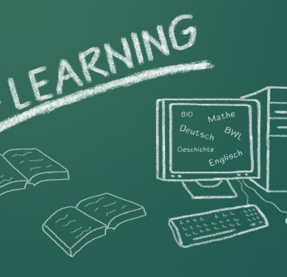
Short look
Notes:
1 First Steps with your Tablet: On / Off / unlock screen; How to open the Sen-App?; What is a good position for the tablet?; Am I online?
2 Get to know your tablet: What is a tablet?; What are the differences between a tablet and a PC?
3 Take a Picture with your Tablet: How to take a picture with the tablet?; How to chose an appropriate cutout?; How to see the picture?; How to see further pictures?
4 Your Learning Environment SenApp: How to use the SenApp learning environment?; What is my personal desktop?; What can I do in the SenApp learning environment?; How can I move through and inbetween the different elements?
5 Write on your tablet: Open the Notes App; How to write a shopping list?; How to correct a shopping list?; How to rearange a shopping list?; How to create a new shopping list?;
6 Get in touch with Mates and Tutors: What is a forum?; How to read a post in SenApp?; How to write a post in SernApp?; How to answer to a post in SenApp ?; Some tips for good posts
7 : Voice entry: How to use voice commands?; How to dictate to my tablet?; How to correct my command and dictate?
8 Search and find on the Internet: How to start a Browser and Google?; How to search for a specific topic?; How to display the search results and call up one result?
9 Read and write E-Mails: How to open the E-Mail-App?; How to write an E-Mail?; How to read an E-Mail?; Some tips for a good E-Mail wiriting
10 Organize your E-Mail: How to organise the E-Mail repository?; How to delete an E-Mail?; How to move E-Mail from one folder to another?
11 Adress book for the E-Mails: How to add a contact to my adress book?; How to add a contact o an E-Mail

Slide 26
SenApp Technical Aspects
fred.neumann@fau.de

Slide 27
Technical Requirements
Simplified User Interface
  Show only the needed Elements
Web Application on iOS
  Hide the Safari Browser Interface
Offline Content on the Tablet
  Caching of HTML Learning Modules
Content Embedding in Native App (Android)
  Service to Query available Contents
R1: Support beginners (Simplify)
R2: Support offline
R3: Support mobile learning
R4: Support iOS
R5: Support Android
R6: Support social learning
R7: Support guidance
Notes:
Zunächst eine kurze Übersicht der Anforderungen, die technisch zu lösen waren. Jede davon wird nachfolgend beschrieben.

Slide 28
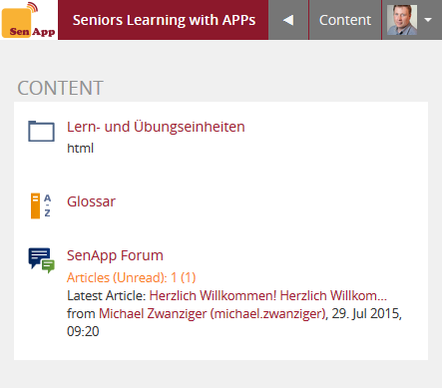
Simplifyed User Interface: Course
No Desktop
No Main Menu
No Locator
No Tabs
Back Button
  To Previous Page
Content Button
  To Main Level
(Realized with SkinTransformer Plugin, ILI)
Notes:
Alle Anpassungen am User Interface wurden mit dem Plugin „SkinTransformer“ durchgeführt, das von ILI ursprünglich für den mobilen Skin von ILIAS entwickelt wurde, aber auch für andere Zwecke einen schnellen und weitreichenden Umbau des ILIAS-Layouts erlaubt, ohne in den Code eingreien zu müssen.

Slide 29
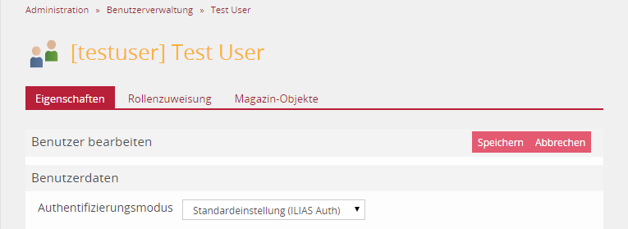
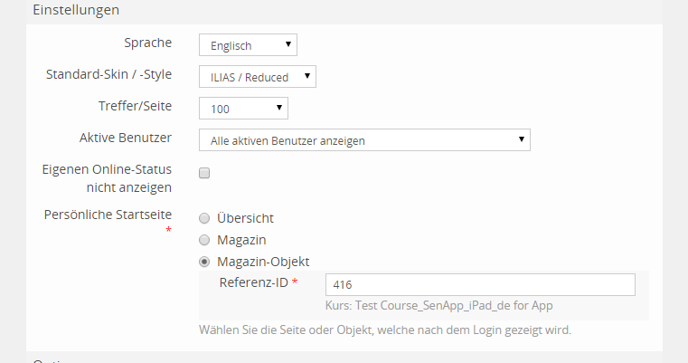
Simpliefyed Set Personal Starting Page
Used after Login
Used by Content Button
Used by App Service
Can be set for a User
by Administrator
Can be set in User Import (Excel File)
Notes:
Im ILIAS-Standard kann die persönliche Startseite nur von den Nutzern selbst geändert werden. Mit der Erweiterung können die Administratoren allen Mitgliedern eines Kurses die Kursseite als Startseite zuweisen.

Slide 30
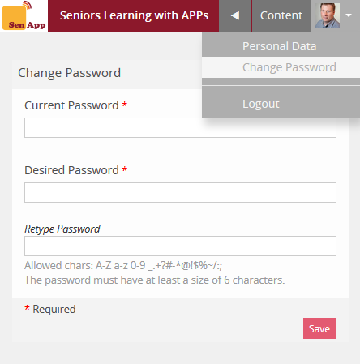
Simplifyed User Interface: Profile
Minimal Personal Data
No Personal Settings
„Change Password“
Link in Top Bar Menu
Reduced Visit Card
(Realized with SkinTransformer Plugin)
Notes:
Die Änderung des Passworts sollte möglichst direkt aufrufbar sein, nicht als Tab der Einstellungen, die ausgeblendet sind.

Slide 31
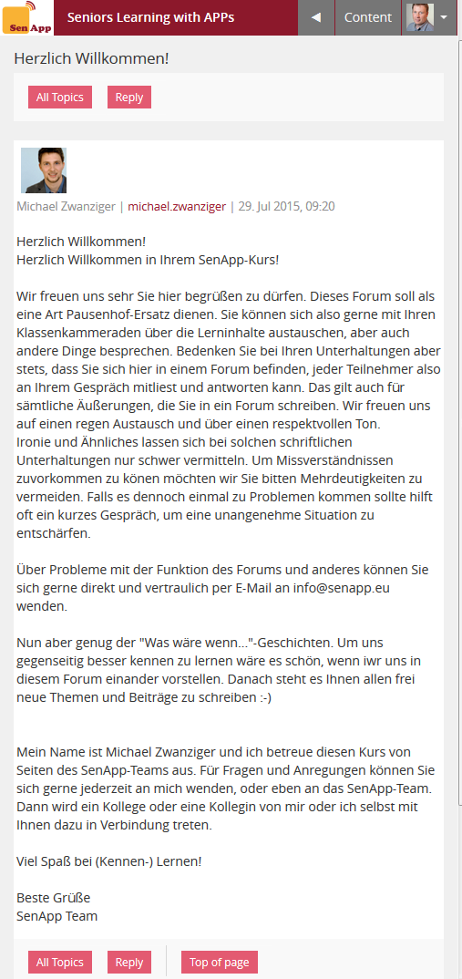
Simplifyed User Interface: Forum
Only View by Date
Thread Title only Once on Top
Hidden Reply for Single Posts
„All Topics“ and „Reply“ as Buttons in Toolbar
(Realized with SkinTransformer Plugin)
Notes:
Im Forum wurde die Navigation stark vereinfacht. Ein Thread wird nur als chronologische Diskussion dargestellt. Die Antwort erfolgt immer auf alle vorangegangenen Beiträge und landed unten.

Slide 32
Challenge Mobile Learning for iOS and Android

Slide 33
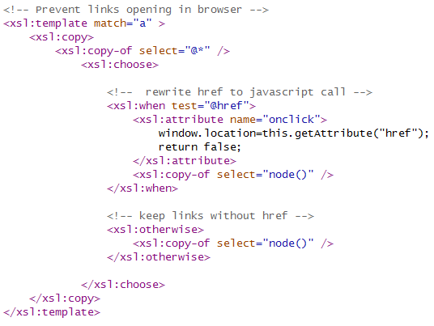
„Smart“ Web Application on iOS
Icon on Home Screen
No Browser Elements
Zoom
Remember login and last page when opened again
Keep Links in Web View
  iOS would switch to Safari
  Links are changed to JavaScript calls
  See Code Example
SkinTransformer Code:
Notes:
Auf dem iPad kann jede Website als Icon auf den Startbildschirm gelegt werden. Beim Aufruf wird der gesamte Bildschirm verwendet und keine Titelleiste des Browsers angezeigt.
Allerdings werden in ILIAS die Navigation und viele Funktionen durch einfache Hyperlinks aufgerufen. Dabei würde das Ipad immer zum normalen Browser wechseln. Mit einer SkinTransformer-Regel (siehe Code) werden alle Hyperlinks so umgeschrieben, dass sie mit einem Javascript-Befahl die aktuelle Seite ersetzen und ILIAS so in der Vollansicht bleibt.
Beim Wechsel zwischen den Apps “vergisst” das iPad das ILIAS-Login und die zuletzt dargestellte Seite. Durch Anpassung der Authentifizierung und Initialisierung merkt sich ILIAS beides.

Slide 34


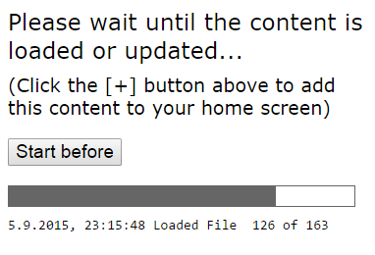
Offline Content on the Tablet
Contents are cached on the tablet when being listed in a „cache manifest“ file
Added a function to create the cache manifest
Added a new starting page for HTML learning modules
Notes:
Moderne Browser können Webinhalte in einem “ApplicationCache” zur Offline-Ansicht speichern, wenn sie auf dem Server in einer einfachen Textdatei (Cache Manifest) verzeichet sind.
Mit einer neuen Funktion in ILIAS kann zu jedem HTML-Lermodul ein Cache Manifest generiert werden. Zusätzlich wird die Startseite des Moduls durch eine Seite ausgetauscht, die den Ladevorgang anzeigt, der auch zur sofortigen Darstellung abgebrochen werden kann.
Die Umsetzung ist experimentell. Sie funktioniert gut mit einfachen Webinhalten, hat aber Probleme mit größeren Videodateien.

Slide 35
Content Embedding in Native App
Android
Simple Service called by the App
Stateless authentication with every request
Query for available contents
JSON encoded data transfer
Functions:
Get all readable HTML Learning Modules
Get all Files in a HTML learning Module
Get all visible Forums
Notes:
Um die Probleme der Offline-Darstellung zu lösen, wurde von Projektpartnern eine native App für Android entwickelt, die als Rahmen für ILIAS-Inhalte dient, die nachgeladen werden.
In ILIAS wurde dazu ein einfacher Service implementiert, der für einen Nutzer alle verfügbaren HTML-Lernmodule und Foren listen kann, sowie zu einem HTML-Lernmodul alle enthaltenen Dateien listet. Der Aufruf erfolgt über einfache statusfreie POST-Requests und liefert JSON-codierte Ergebnisse.
Die benötigten Dateien können von der App geladen und offline angezeigt werden. Foren werden von der App in einem WebView-Rahmen dargestellt.

Slide 36
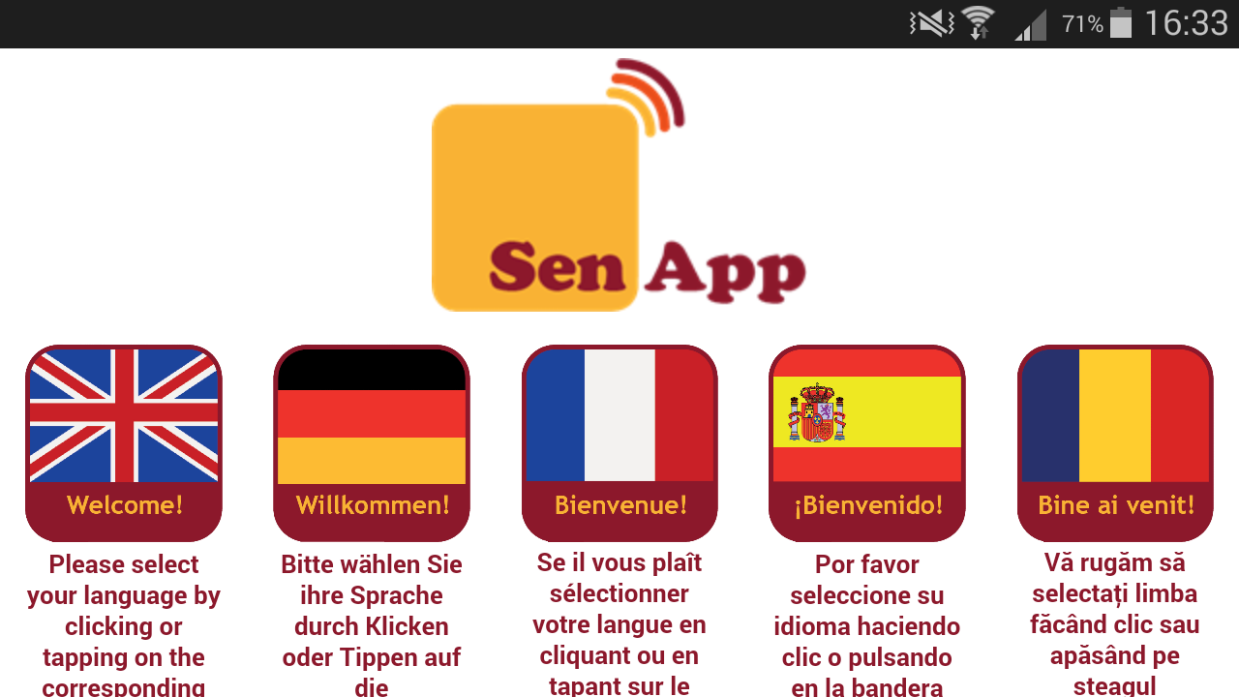

Slide 37
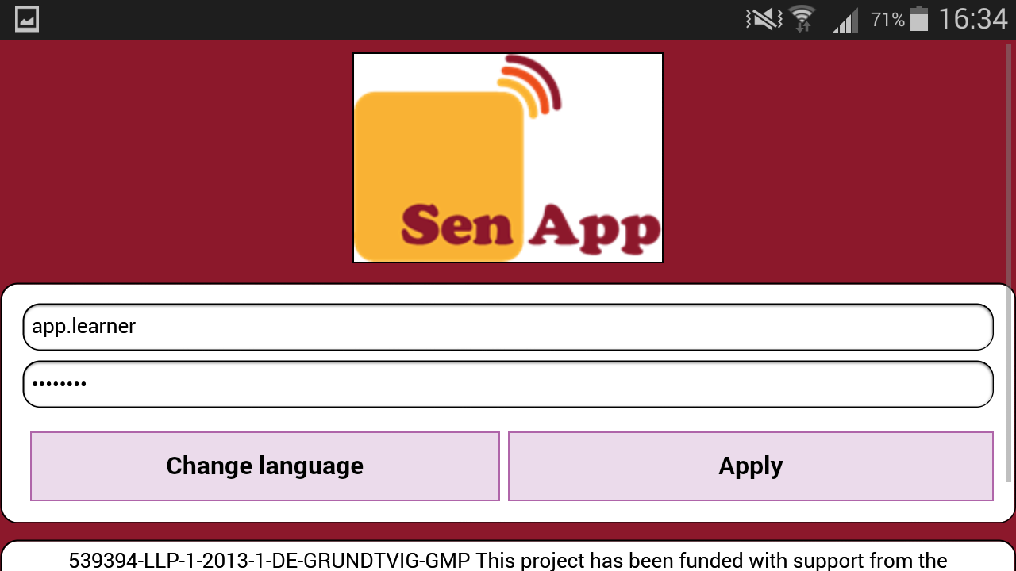

Slide 38
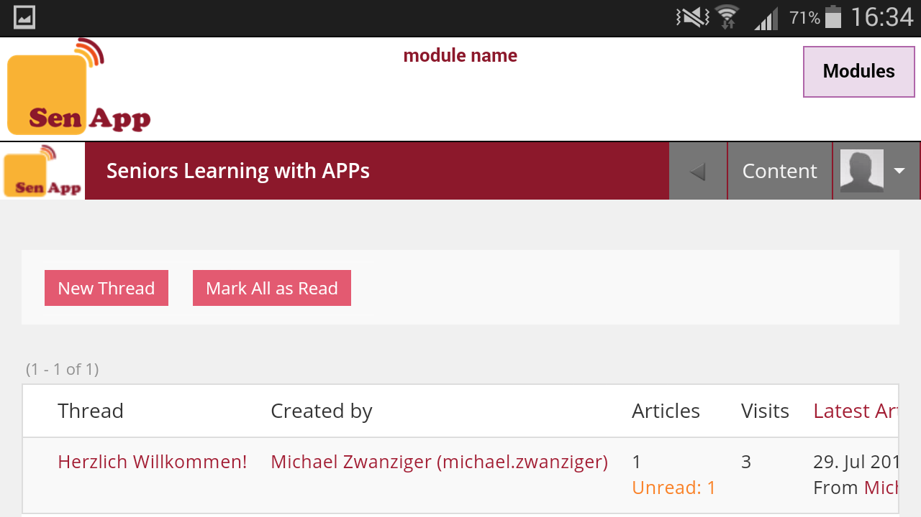

Slide 39
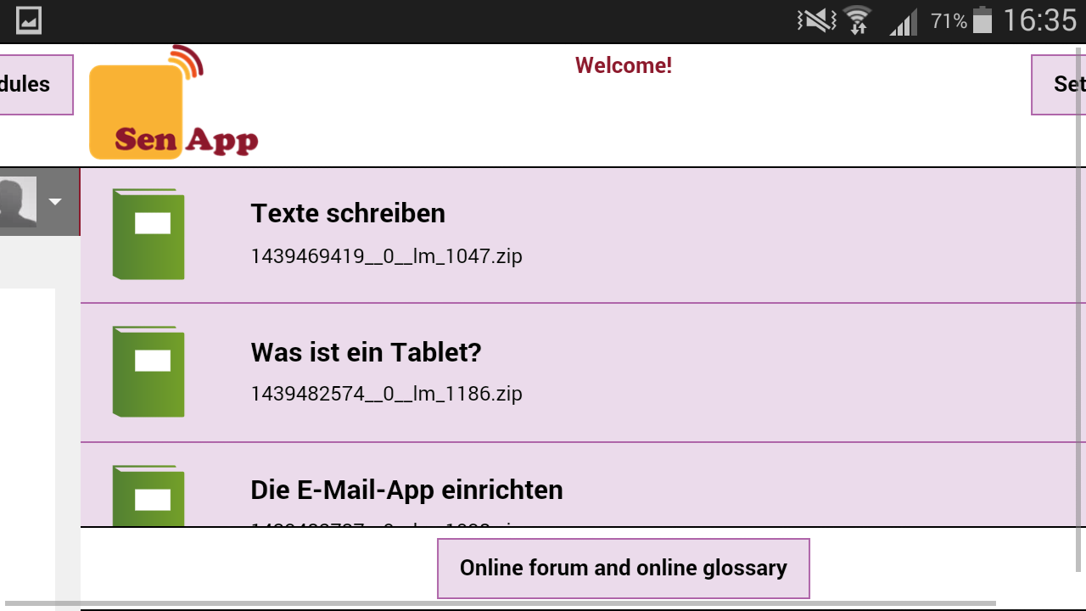
Learning Units Overview

Slide 40
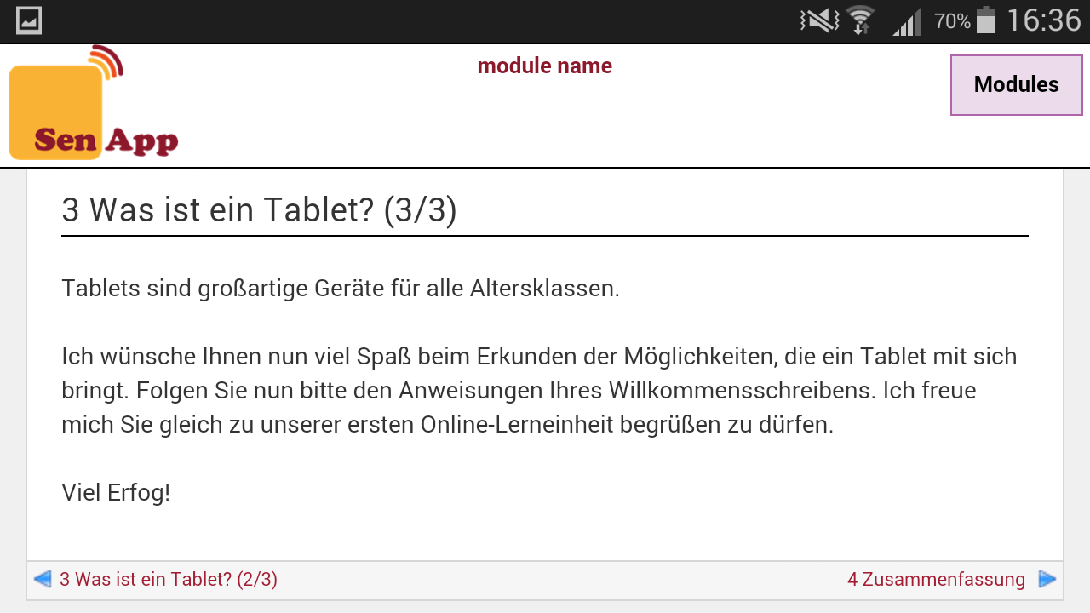

Slide 41
Summary
Challenging group, challenging re-design
Bi-directional process
Leading to...
  Simplication / easy to use
  Offline possibilities
  Different languages
  Continuous content update (forum and learning materials)

Slide 42
Thank you for your time!
fred.neumann@fau.de
michael.zwanziger@fau.de
sonia.hetzner@fau.de
www.senapp.eu
www.ili.fau.de

